Slide 1
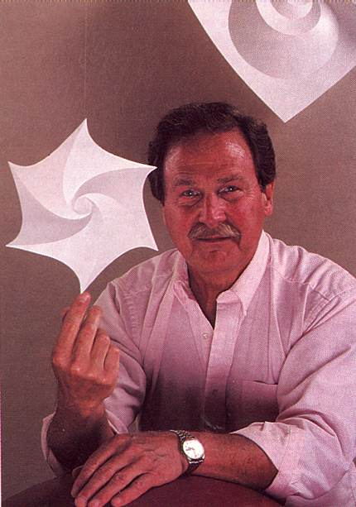

Slide 2
1
0
1
0
1
0
T
G
C
A

Slide 3
1
0
A
1
0
C
1
0
T
G

Slide 4
17
0
1
7
0
10
1
3
1
0
1
0
A
6
B
4
C
4
G
1
H
2

